Slide 1
Lalitha Priya Bhupalam
Mehdi Naderi Varandi
Yavor Edipov
James Craster
Oluwafemi Oladipo
Iurii Maksymets
Autistica Challenge
Team 21

Slide 2
Aim
Automate
Automate the resources and steps needed for a longitudinal study
Create
Create great user experience
Provide
Provide critical insights to researchers and employers

Slide 3
Difficult to Reach more people
Misdiagnoses can occur due to lack of understanding/studies done solely on men
Challenges for the Client

Slide 4
Live Tech Demo

Slide 5
Easily accessible by anyone, on any device
Simple and easy to use
Extremely customizable – suits any users needs
Provides immediate insight
Allows researcher/employer to customise and add new questions
Benefits and advantages of our solution

Slide 6
How do we meet the judging criteria?
Fit to NGO Challenge/Need | How well does the proposed solution respond to the NGO challenge statement? How creative is the solution? Is it doing more than just leveraging existing technologies?
Level of Innovation | How creative is the solution? Is it doing more than just leveraging existing technologies?
Quality of Pitch | How well did the participants pitch their solution? How will did the participants respond to questions?
Completeness of Solution | Does the solution work? Was a roadmap completed and presented for unfinished items?
Sustainability/Feasibility | Is this a solution that the NGO can take and build on? Is the solution Frankenware (technologies mashed together for a short-term fix)? Is the solution financially sustainable? Can it realistically be executed?

Slide 7
Roadmap
In the future, we can:
Leverage NLP to provide insights about qualitative data
Most of the work on this is done already!
Provide more buttons like the ability to skip
Make solution even more accessible for others e.g. deaf, blind

Slide 8
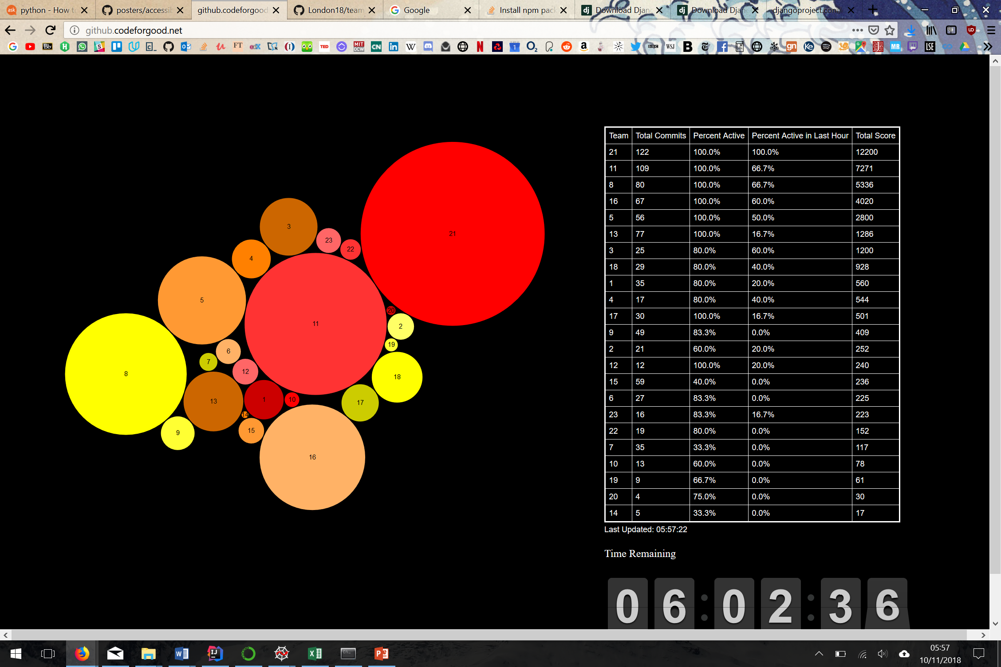
Our Accreditations and awards
21
21

Slide 9
Thank you for listening!

